Slide 1
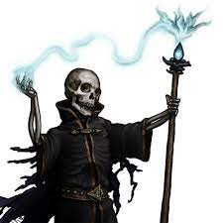
The Night of the Lich
Pitch Date: 12/18/2022 Update 3/19/2023
Release Date: 4/9/2023 210 Commits (+24)
Team Lead: Vince McKeown 13 Contributors (+2)
1
2
3
4
5
6
7
8
9
10
11
12
13
14
15
16

Slide 2
Vince McKeown
Coding:
Removed stationary leaf’s
Fixed camera panning between scenes
Animated Lich walking North

Slide 3
Jasmine Hegman
Animated the Pause Screen
Fixed lighting to inside/outside
Corrected Max health displayed
Debug screen added back in

Slide 4

Kyle Knutson
Wagon
Skeleton Attacking

Slide 5
Christer “McFunkyPants” Kaitila
Bug Fix
Roof Transition
Prevent NPC’s from attacking
SFX
Sword, Arrows, footsteps, and door open/closing

